Slide 1
Stacks

Slide 2
Outline
3.2
This topic discusses the concept of a stack:
Description of an Abstract Stack
List applications
Implementation
Example applications
Parsing: XHTML, C++
Function calls
Reverse-Polish calculators
Robert’s Rules
Standard Template Library

Slide 3
Abstract Stack
3.2.1
An Abstract Stack (Stack ADT) is an abstract data type which emphasizes specific operations:
Uses a explicit linear ordering
Insertions and removals are performed individually
Inserted objects are pushed onto the stack
The top of the stack is the most recently object pushed onto the stack
When an object is popped from the stack, the current top is erased

Slide 4
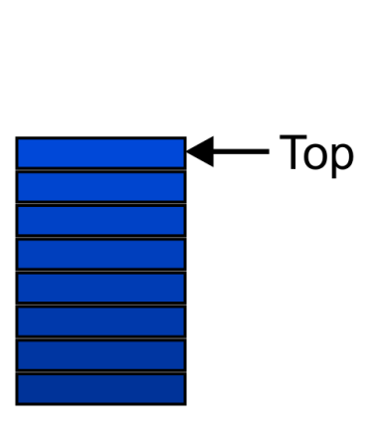
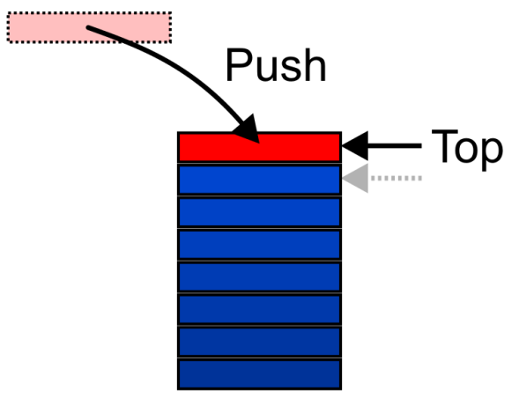
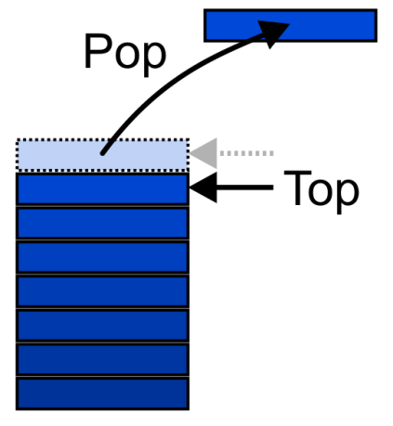
Abstract Stack
3.2.1
Also called a last-in–first-out (LIFO) behaviour
Graphically, we may view these operations as follows:
There are two exceptions associated with abstract stacks:
It is an undefined operation to call either pop or top on an empty stack

Slide 5
Applications
3.2.2
Numerous applications:
Parsing code:
Matching parenthesis
XML (e.g., XHTML)
Tracking function calls
Dealing with undo/redo operations
Reverse-Polish calculators
Assembly language
The stack is a very simple data structure
Given any problem, if it is possible to use a stack, this significantly simplifies the solution

Slide 6
Stack: Applications
3.2.2
Problem solving:
Solving one problem may lead to subsequent problems
These problems may result in further problems
As problems are solved, your focus shifts back to the problem which lead to the solved problem
Notice that function calls behave similarly:
A function is a collection of code which solves a problem
Reference: Donald Knuth

Slide 7
Implementations
3.2.3
We will look at two implementations of stacks:
The optimal asymptotic run time of any algorithm is Θ(1)
The run time of the algorithm is independent of the number of objects being stored in the container
We will always attempt to achieve this lower bound
We will look at
Singly linked lists
One-ended arrays

Slide 8
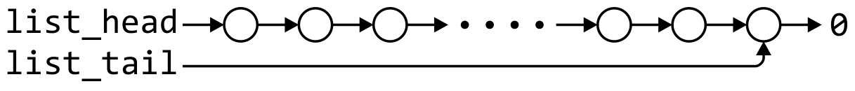
Linked-List Implementation
3.2.3.1
Operations at the front of a singly linked list are all Θ(1)
The desired behaviour of an Abstract Stack may be reproduced by performing all operations at the front
 | Front/1st | Back/n^{th}
Find | Θ(1) | Θ(1)
Insert | Θ(1) | Θ(1)
Erase | Θ(1) | Θ(n)

Slide 9
Single_list Definition
3.2.3.1
The definition of single list class from Project 1 is:
template <typename Type>
class Single_list {
public:
Single_list();
~Single_list();
int size() const;
bool empty() const;
Type front() const;
Type back() const;
Single_node<Type> *head() const;
Single_node<Type> *tail() const;
int count( Type const & ) const;
void push_front( Type const & );
void push_back( Type const & );
Type pop_front();
int erase( Type const & );
};

Slide 10
Stack-as-List Class
3.2.3.1
The stack class using a singly linked list has a single private member variable:
template <typename Type>
class Stack {
private:
Single_list<Type> list;
public:
bool empty() const;
Type top() const;
void push( Type const & );
Type pop();
};

Slide 11
Stack-as-List Class
3.2.3.1
template <typename Type>
class Stack {
private:
Single_list<Type> list;
public:
bool empty() const;
Type top() const;
void push( Type const & );
Type pop();
};
A constructor and destructor is not needed
Because list is declared, the compiler will call the constructor of the Single_list class when the Stack is constructed
Notes:
11

Slide 12
Stack-as-List Class
3.2.3.1
The empty and push functions just call the appropriate functions of the Single_list class
template <typename Type>
bool Stack<Type>::empty() const {
return list.empty();
}
template <typename Type>
void Stack<Type>::push( Type const &obj ) {
list.push_front( obj );
}
Notes:
12

Slide 13
Stack-as-List Class
3.2.3.1
The top and pop functions, however, must check the boundary case:
template <typename Type>
Type Stack<Type>::top() const {
if ( empty() ) {
throw underflow();
}
return list.front();
}
template <typename Type>
Type Stack<Type>::pop() {
if ( empty() ) {
throw underflow();
}
return list.pop_front();
}

Slide 14
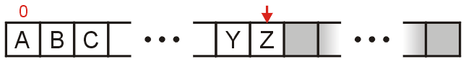
Array Implementation
3.2.3.2
For one-ended arrays, all operations at the back are Θ(1)
 | Front/1st | Back/n^{th}
Find | Θ(1) | Θ(1)
Insert | Θ(n) | Θ(1)
Erase | Θ(n) | Θ(1)

Slide 15
Destructor
3.2.3.2
We need to store an array:
In C++, this is done by storing the address of the first entry
Type *array;
We need additional information, including:
The number of objects currently in the stack
int stack_size;
The capacity of the array
int array_capacity;
Notes:
15

Slide 16
Stack-as-Array Class
3.2.3.2
We need to store an array:
In C++, this is done by storing the address of the first entry
template <typename Type>
class Stack {
private:
int stack_size;
int array_capacity;
Type *array;
public:
Stack( int = 10 );
~Stack();
bool empty() const;
Type top() const;
void push( Type const & );
Type pop();
};

Slide 17
Constructor
3.2.3.2
The class is only storing the address of the array
We must allocate memory for the array and initialize the member variables
The call to new Type[array_capacity] makes a request to the operating system for array_capacity objects
#include <algorithm>
// ...
template <typename Type>
Stack<Type>::Stack( int n ):
stack_size( 0 ),
array_capacity( std::max( 1, n ) ),
array( new Type[array_capacity] ) {
// Empty constructor
}

Slide 18
Constructor
3.2.3.2
template <typename Type>
class Stack {
private:
int stack_size;
int array_capacity;
Type *array;
public:
Stack( int = 10 );
~Stack();
bool empty() const;
Type top() const;
void push( Type const & );
Type pop();
};
template <typename Type>
Stack<Type>::Stack( int n ):
stack_size( 0 ),
array_capacity( std::max( 1, n ) ),
array( new Type[array_capacity] ) {
// Empty constructor
}
Warning: in C++, the variables are initialized in the order in which they are defined:
Notes:
18

Slide 19
Destructor
3.2.3.2
The call to new in the constructor requested memory from the operating system
The destructor must return that memory to the operating system:
template <typename Type>
Stack<Type>::~Stack() {
delete [] array;
}

Slide 20
Empty
3.2.3.2
The stack is empty if the stack size is zero:
template <typename Type>
bool Stack<Type>::empty() const {
return ( stack_size == 0 );
}
The following is unnecessarily tedious:
The == operator evaluates to either true or false
if ( stack_size == 0 ) {
return true;
} else {
return false;
}

Slide 21
Top
3.2.3.2
If there are n objects in the stack, the last is located at index n – 1
template <typename Type>
Type Stack<Type>::top() const {
if ( empty() ) {
throw underflow();
}
return array[stack_size - 1];
}
Notes:
21

Slide 22
Pop
3.2.3.2
Removing an object simply involves reducing the size
It is invalid to assign the last entry to “0”
By decreasing the size, the previous top of the stack is now at the location stack_size
template <typename Type>
Type Stack<Type>::pop() {
if ( empty() ) {
throw underflow();
}
--stack_size;
return array[stack_size];
}
Notes:
22

Slide 23
Push
3.2.3.2
Pushing an object onto the stack can only be performed if the array is not full
template <typename Type>
void Stack<Type>::push( Type const &obj ) {
if ( stack_size == array_capacity ) {
throw overflow(); // Best solution?????
}
array[stack_size] = obj;
++stack_size;
}

Slide 24
Exceptions
3.2.3.2
The case where the array is full is not an exception defined in the Abstract Stack
If the array is filled, we have five options:
Increase the size of the array
Throw an exception
Ignore the element being pushed
Replace the current top of the stack
Put the pushing process to “sleep” until something else removes the top of the stack
Include a member function bool full() const;

Slide 25
Array Capacity
3.2.4
If dynamic memory is available, the best option is to increase the array capacity
If we increase the array capacity, the question is:
How much?
By a constant? array_capacity += c;
By a multiple? array_capacity *= c;

Slide 26
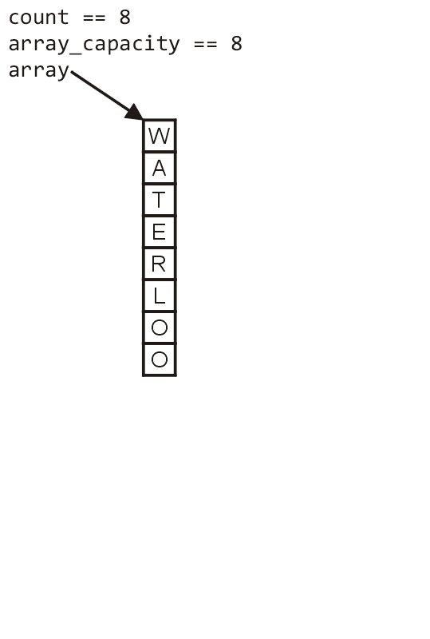
Array Capacity
3.2.4
First, let us visualize what must occur to allocate new memory

Slide 27
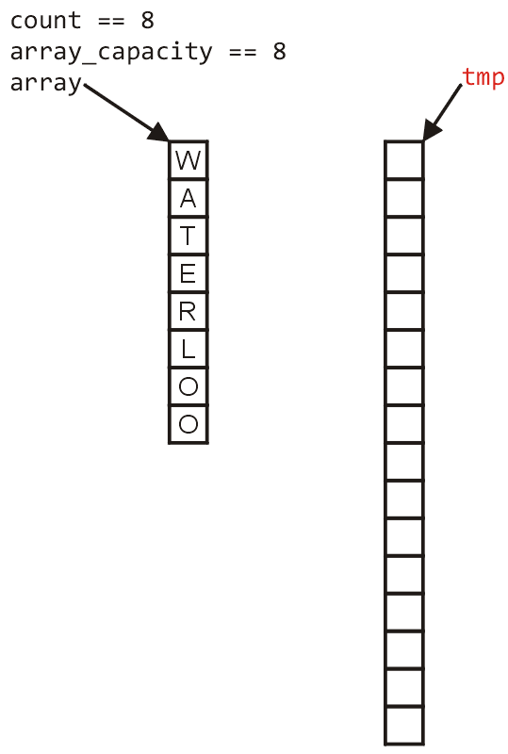
Array Capacity
3.2.4
First, this requires a call to new Type[N] where N is the new capacity
We must have access to this so we must store the address returned by new in a local variable, say tmp

Slide 28
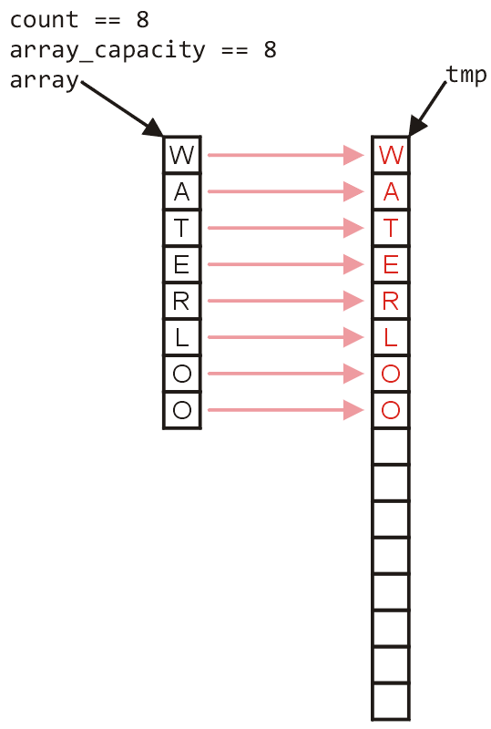
Array Capacity
3.2.4
Next, the values must be copied over

Slide 29
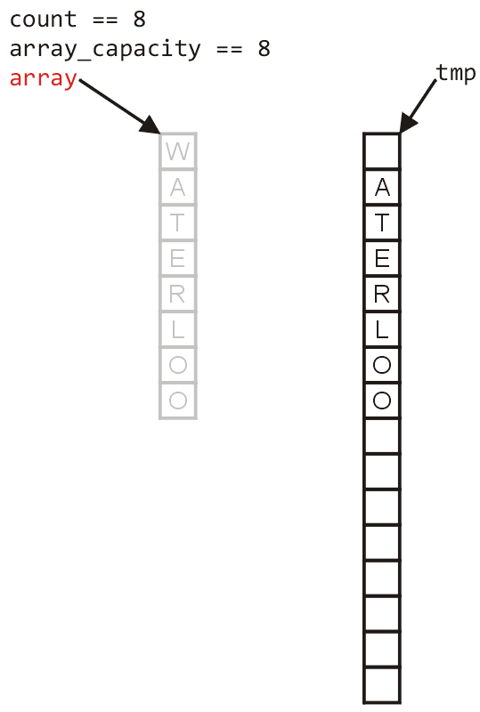
Array Capacity
3.2.4
W
The memory for the original array must be deallocated

Slide 30
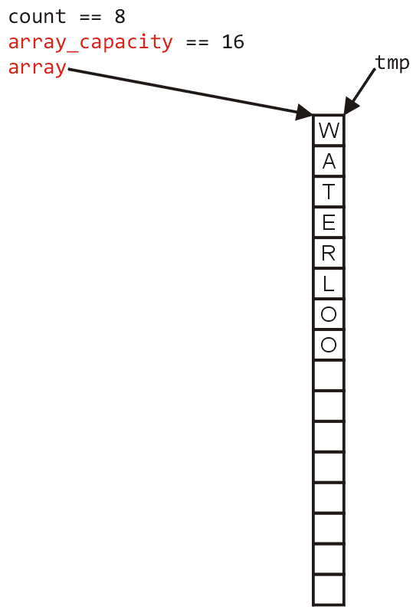
Array Capacity
3.2.4
Finally, the appropriate member variables must be reassigned

Slide 31
Array Capacity
3.2.4
The implementation:
void double_capacity() {
Type *tmp_array = new Type[2*array_capacity];
}

Slide 32
Array Capacity
3.2.4
tmp_array
The implementation:
void double_capacity() {
Type *tmp_array = new Type[2*array_capacity];
}

Slide 33
Array Capacity
3.2.4
tmp_array
The implementation:
void double_capacity() {
Type *tmp_array = new Type[2*array_capacity];
for ( int i = 0; i < array_capacity; ++i ) {
tmp_array[i] = array[i];
}
}

Slide 34
Array Capacity
3.2.4
tmp_array
W
The implementation:
void double_capacity() {
Type *tmp_array = new Type[2*array_capacity];
for ( int i = 0; i < array_capacity; ++i ) {
tmp_array[i] = array[i];
}
delete [] array;
}

Slide 35
Array Capacity
3.2.4
tmp_array
The implementation:
void double_capacity() {
Type *tmp_array = new Type[2*array_capacity];
for ( int i = 0; i < array_capacity; ++i ) {
tmp_array[i] = array[i];
}
delete [] array;
array = tmp_array;
array_capacity *= 2;
}

Slide 36
Array Capacity
3.2.4
Back to the original question:
How much do we change the capacity?
Add a constant?
Multiply by a constant?
First, we recognize that any time that we push onto a full stack, this requires n copies and the run time is Θ(n)
Therefore, push is usually Θ(1) except when new memory is required

Slide 37
Array Capacity
3.2.4
To state the average run time, we will introduce the concept of amortized time:
If n operations requires Θ(f(n)), we will say that an individual operation has an amortized run time of Θ(f(n)/n)
Therefore, if inserting n objects requires:
Θ(n²) copies, the amortized time is Θ(n)
Θ(n) copies, the amortized time is Θ(1)

Slide 38
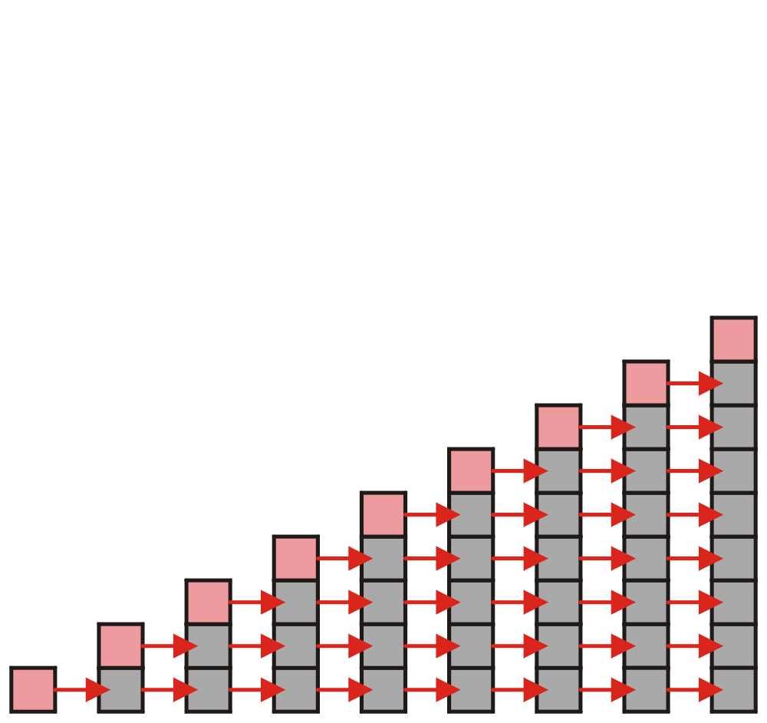
Array Capacity
3.2.4
Let us consider the case of increasing the capacity by 1 each time the array is full
With each insertion when the array is full, this requires all entries to be copied

Slide 39
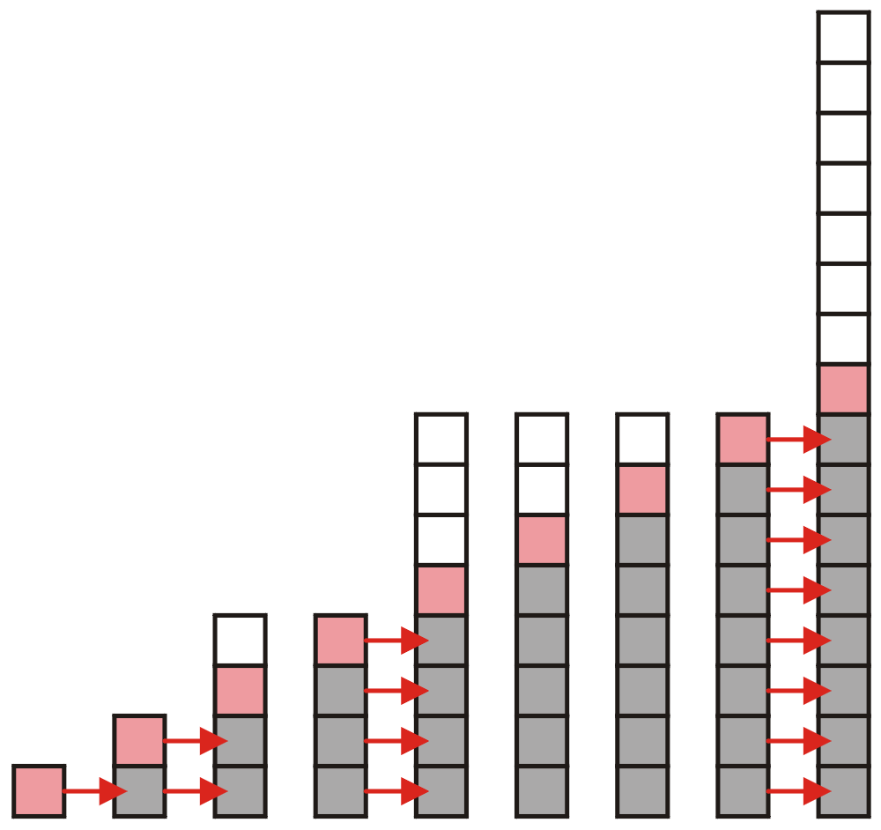
Array Capacity
3.2.4
Suppose we double the number of entries each time the array is full
Now the number of copies appears to be significantly fewer

Slide 40
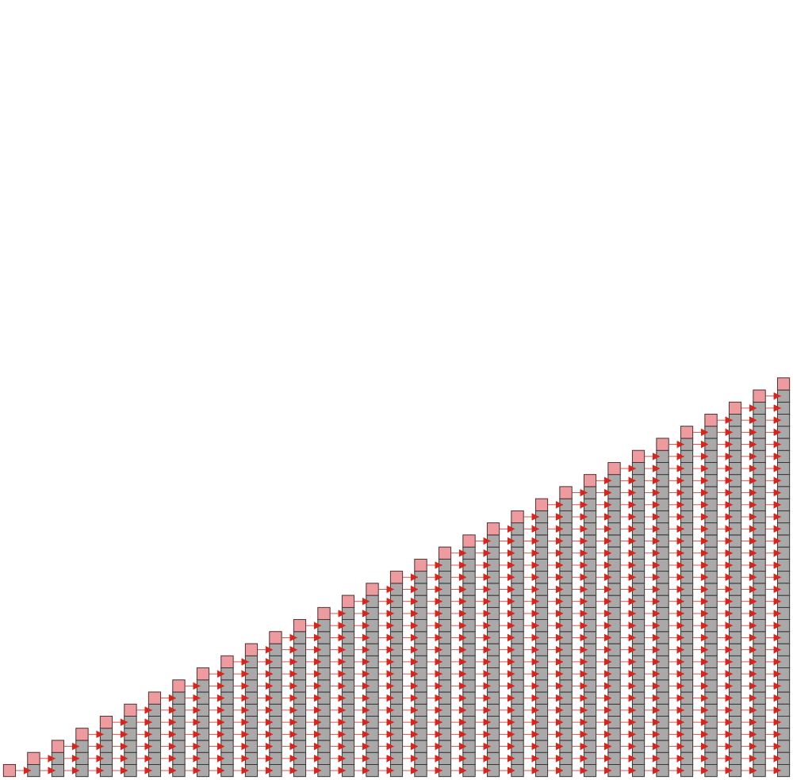
Array Capacity
3.2.4.1
Suppose we insert n objects
The pushing of the k^{th} object on the stack requires k – 1 copies
The total number of copies is now given by:
Therefore, the amortized number of copies is given by
Therefore each push must run in Θ(n) time
The wasted space, however is Θ(1)

Slide 41
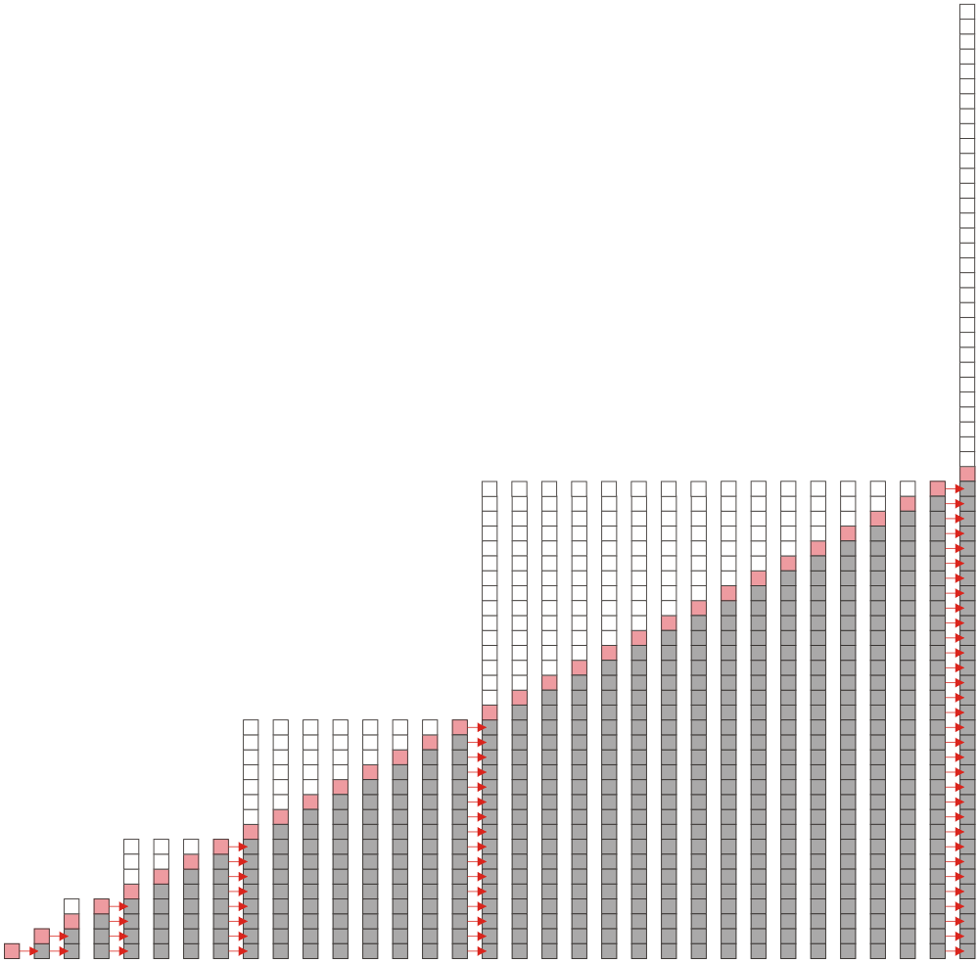
Array Capacity
3.2.4.2
Suppose we double the array size each time it is full:
This is difficult to solve for an arbitrary n so instead, we will restrict the number of objects we are inserting to n = 2^{h} objects
We will then assume that the behavior for intermediate values of n will be similar

Slide 42
Array Capacity
3.2.4.2
Suppose we double the array size each time it is full:
Inserting n = 2^{h} objects would therefore require
1, 2, 4, 8, …, 2^{h–1}
copies, for once we add the last object, the array will be full
The total number of copies is therefore:
Therefore the amortized number of copies per insertion is Θ(1)
The wasted space, however is O(n)

Slide 43
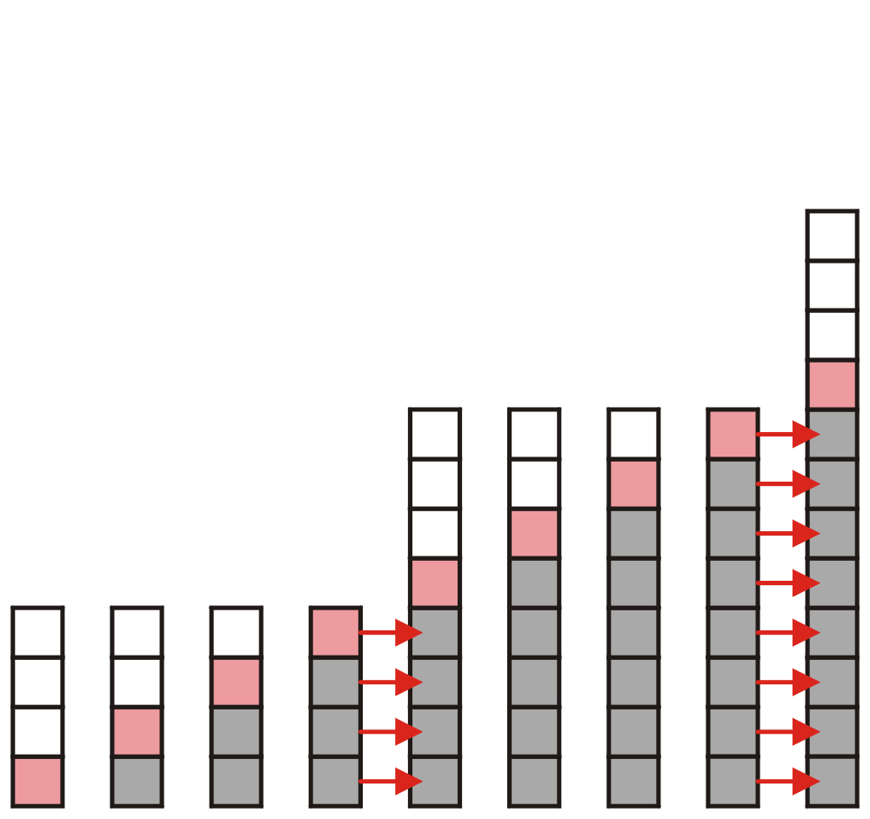
Array Capacity
3.2.4.3
What if we increase the array size by a larger constant?
For example, increase the array size by 4, 8, 100?

Slide 44
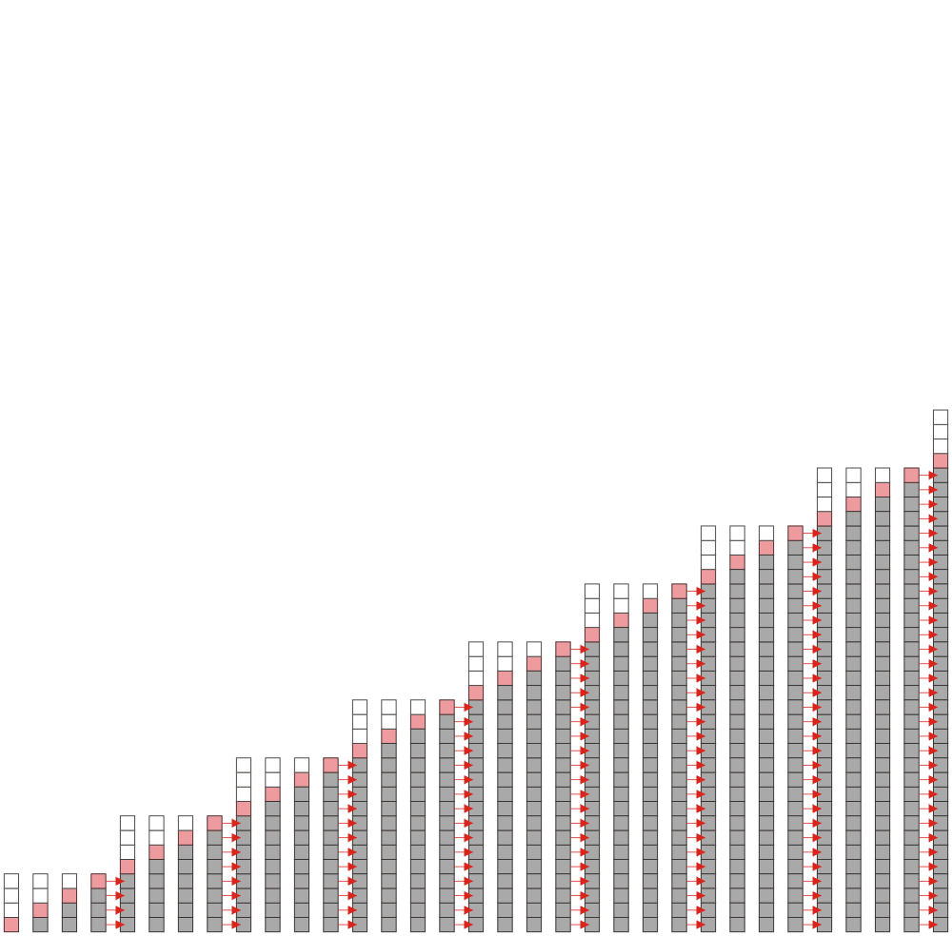
Array Capacity
3.2.4.3
Suppose we increase it by a constant value m and we add n = ℓm objects
To add n items, we will have to make
m, 2m, 3m, …, (ℓ – 1)m
copies in total, or
The amoritized number of copies is
as m is fixed

Slide 45
Array Capacity
3.2.4.3
 | Copies per Insertion | Unused Memory
Increase by 1 | n – 1 | 0
Increase by m | n/m | m – 1
Increase by a factor of 2 | 1 | n
Increase by a factor of r > 1 | 1/(r – 1) | (r – 1)n
Note the difference in worst-case amortized scenarios:
The web site
http://www.ece.uwaterloo.ca/~ece250/Algorithms/Array_resizing/
discusses the consequences of various values of r

Slide 46
Application: Parsing
3.2.5
Most parsing uses stacks
Examples includes:
Matching tags in XHTML
In C++, matching
parentheses ( ... )
brackets, and [ ... ]
braces { ... }

Slide 47
Parsing XHTML
3.2.5.1
The first example will demonstrate parsing XHTML
We will show how stacks may be used to parse an XHTML document
You will use XHTML (and more generally XML and other markup languages) in the workplace

Slide 48
Parsing XHTML
3.2.5.1
A markup language is a means of annotating a document to given context to the text
The annotations give information about the structure or presentation of the text
The best known example is HTML, or HyperText Markup Language
We will look at XHTML

Slide 49
Parsing XHTML
3.2.5.1
XHTML is made of nested
opening tags, e.g., <some_identifier>, and
matching closing tags, e.g., </some_identifier>
<html>
<head><title>Hello</title></head>
<body><p>This appears in the <i>browser</i>.</p></body>
</html>

Slide 50
Parsing XHTML
3.2.5.1
Nesting indicates that any closing tag must match the most recent opening tag
Strategy for parsing XHTML:
read though the XHTML linearly
place the opening tags in a stack
when a closing tag is encountered, check that it matches what is on top of the stack and

Slide 51
Parsing XHTML
3.2.5.1
<html>
<head><title>Hello</title></head>
<body><p>This appears in the <i>browser</i>.</p></body>
</html>
<html>

Slide 52
Parsing XHTML
3.2.5.1
<html>
<head><title>Hello</title></head>
<body><p>This appears in the <i>browser</i>.</p></body>
</html>
<html> | <head>

Slide 53
Parsing XHTML
3.2.5.1
<html>
<head><title>Hello</title></head>
<body><p>This appears in the <i>browser</i>.</p></body>
</html>
<html> | <head> | <title>

Slide 54
Parsing XHTML
3.2.5.1
<html>
<head><title>Hello</title></head>
<body><p>This appears in the <i>browser</i>.</p></body>
</html>
<html> | <head> | <title>

Slide 55
Parsing XHTML
3.2.5.1
<html>
<head><title>Hello</title></head>
<body><p>This appears in the <i>browser</i>.</p></body>
</html>
<html> | <head>

Slide 56
Parsing XHTML
3.2.5.1
<html>
<head><title>Hello</title></head>
<body><p>This appears in the <i>browser</i>.</p></body>
</html>
<html> | <body>

Slide 57
Parsing XHTML
3.2.5.1
<html>
<head><title>Hello</title></head>
<body><p>This appears in the <i>browser</i>.</p></body>
</html>
<html> | <body> | <p>

Slide 58
Parsing XHTML
3.2.5.1
<html>
<head><title>Hello</title></head>
<body><p>This appears in the <i>browser</i>.</p></body>
</html>
<html> | <body> | <p> | <i>

Slide 59
Parsing XHTML
3.2.5.1
<html>
<head><title>Hello</title></head>
<body><p>This appears in the <i>browser</i>.</p></body>
</html>
<html> | <body> | <p> | <i>

Slide 60
Parsing XHTML
3.2.5.1
<html>
<head><title>Hello</title></head>
<body><p>This appears in the <i>browser</i>.</p></body>
</html>
<html> | <body> | <p>

Slide 61
Parsing XHTML
3.2.5.1
<html>
<head><title>Hello</title></head>
<body><p>This appears in the <i>browser</i>.</p></body>
</html>
<html> | <body>

Slide 62
Parsing XHTML
3.2.5.1
<html>
<head><title>Hello</title></head>
<body><p>This appears in the <i>browser</i>.</p></body>
</html>
<html>

Slide 63
Parsing XHTML
3.2.5.1
We are finished parsing, and the stack is empty
Possible errors:
a closing tag which does not match the opening tag on top of the stack
a closing tag when the stack is empty
the stack is not empty at the end of the document

Slide 64
HTML
3.2.5.1
Old HTML required neither closing tags nor nesting
<html>
<head><title>Hello</title></head>
<body><p>This is a list of topics:
<ol> <!-- para ends with start of list -->
<li><i>veni <!-- implied </li> -->
<li>vidi <!-- italics continues -->
<li>vici</i>
</ol> <!-- end-of-file implies </body></html> -->
Parsers were therefore specific to HTML
Results: ambiguities and inconsistencies

Slide 65
XML
3.2.5.1
XHTML is an implementation of XML
XML defines a class of general-purpose eXtensible Markup Languages designed for sharing information between systems
The same rules apply for any flavour of XML:
opening and closing tags must match and be nested

Slide 66
Parsing C++
3.2.5.2
The next example shows how stacks may be used in parsing C++
Those taking ECE 351 Compilers will use this
For other students, it should help understand, in part:
how a compiler works, and
why programming languages have the structure they do

Slide 67
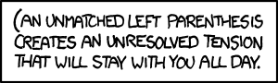
Parsing C++
3.2.5.2
Like opening and closing tags, C++ parentheses, brackets, and braces must be similarly nested:
void initialize( int *array, int n ) {
for ( int i = 0; i < n; ++i ) {
array[i] = 0;
}
}
http://xkcd.com/859/

Slide 68
Parsing C++
3.2.5.2
For C++, the errors are similar to that for XHTML, however:
many XHTML parsers usually attempt to “correct” errors (e.g., insert missing tags)
C++ compilers will simply issue a parse error:
{eceunix:1} cat example1.cpp
#include <vector>
int main() {
std::vector<int> v(100];
return 0;
}
{eceunix:2} g++ example1.cpp
example1.cpp: In function 'int main()':
example1.cpp:3: error: expected ')' before ']' token

Slide 69
Parsing C++
3.2.5.2
For C++, the errors are similar to that for XHTML, however:
many XHTML parsers usually attempt to “correct” errors (e.g., insert missing tags)
C++ compilers will simply issue a parse error:
{eceunix:1} cat example2.cpp
#include <vector>
int main() {
std::vector<int> v(100);
v[0] = 3];
return 0;
}
{eceunix:2} g++ example2.cpp
example2.cpp: In function 'int main()':
example2.cpp:4: error: expected ';' before ']' token

Slide 70
Function Calls
3.2.5.3
This next example discusses function calls
In ECE 222 Digital Computers, you will see how stacks are implemented in hardware on all CPUs to facilitate function calling
The simple features of a stack indicate why almost all programming languages are based on function calls

Slide 71
Function Calls
3.2.5.3
Function calls are similar to problem solving presented earlier:
you write a function to solve a problem
the function may require sub-problems to be solved, hence, it may call another function
once a function is finished, it returns to the function which called it

Slide 72
Function Calls
3.2.5.3
You will notice that the when a function returns, execution and the return value is passed back to the last function which was called
This is again, the last-in—first-out property
Covered in much greater detail in ECE 222
Today’s CPUs have hardware specifically designed to facilitate function calling

Slide 73
Reverse-Polish Notation
3.2.5.4
Normally, mathematics is written using what we call in-fix notation:
(3 + 4) × 5 – 6
The operator is placed between to operands
One weakness: parentheses are required
(3 + 4) × 5 – 6 = 29
3 + 4 × 5 – 6 = 17
3 + 4 × (5 – 6) = –1
(3 + 4) × (5 – 6) = –7

Slide 74
Reverse-Polish Notation
3.2.5.4
Alternatively, we can place the operands first, followed by the operator:
(3 + 4) × 5 – 6
3 4 + 5 × 6 –
Parsing reads left-to-right and performs any operation on the last two operands:
3 4 + 5 × 6 –
7 5 × 6 –
35 6 –
29

Slide 75
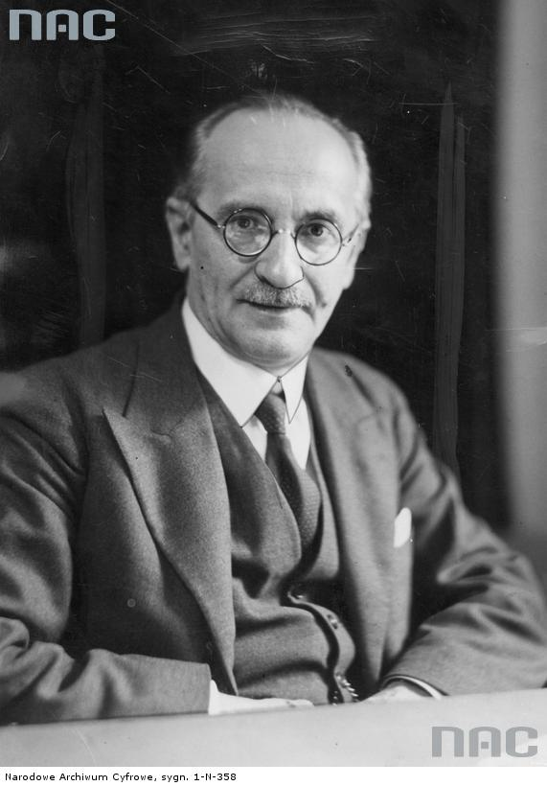
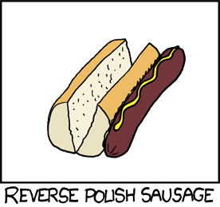
Reverse-Polish Notation
3.2.5.4
This is called reverse-Polish notation after the mathematician Jan Łukasiewicz
As you will see in ECE 222, this forms the basis of the recursive stack used on all processors
He also made significant contributions to logic and other fields
Including humour…
http://www.audiovis.nac.gov.pl/
http://xkcd.com/645/

Slide 76
Reverse-Polish Notation
3.2.5.4
Other examples:
3 4 5 × + 6 –
3 20 + 6 –
23 6 –
17
3 4 5 6 – × +
3 4 –1 × +
3 –4 +
–1

Slide 77
Reverse-Polish Notation
3.2.5.4
Benefits:
No ambiguity and no brackets are required
It is the same process used by a computer to perform computations:
operands must be loaded into registers before operations can be performed on them
Reverse-Polish can be processed using stacks

Slide 78

Reverse-Polish Notation
3.2.5.4
Reverse-Polish notation is used with some programming languages
e.g., postscript, pdf, and HP calculators
Similar to the thought process required for writing assembly language code
you cannot perform an operation until you have all of the operands loaded into registers
MOVE.L #$2A, D1 ; Load 42 into Register D1
MOVE.L #$100, D2 ; Load 256 into Register D2
ADD D2, D1 ; Add D2 into D1

Slide 79
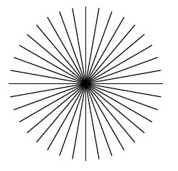
Reverse-Polish Notation
3.2.5.4
A quick example of postscript:
0 10 360 { % Go from 0 to 360 degrees in 10-degree steps
newpath % Start a new path
gsave % Keep rotations temporary
144 144 moveto
rotate % Rotate by degrees on stack from 'for'
72 0 rlineto
stroke
grestore % Get back the unrotated state
} for % Iterate over angles
http://www.tailrecursive.org/postscript/examples/rotate.html

Slide 80
Reverse-Polish Notation
3.2.5.4
The easiest way to parse reverse-Polish notation is to use an operand stack:
operands are processed by pushing them onto the stack
when processing an operator:
pop the last two items off the operand stack,
perform the operation, and
push the result back onto the stack

Slide 81
Reverse-Polish Notation
3.2.5.4
Evaluate the following reverse-Polish expression using a stack:
1 2 3 + 4 5 6 × – 7 × + – 8 9 × +

Slide 82
Reverse-Polish Notation
3.2.5.4
Push 1 onto the stack
1 2 3 + 4 5 6 × – 7 × + – 8 9 × +
1

Slide 83
Reverse-Polish Notation
3.2.5.4
Push 1 onto the stack
1 2 3 + 4 5 6 × – 7 × + – 8 9 × +
2
1

Slide 84
Reverse-Polish Notation
3.2.5.4
Push 3 onto the stack
1 2 3 + 4 5 6 × – 7 × + – 8 9 × +
3
2
1

Slide 85
Reverse-Polish Notation
3.2.5.4
Pop 3 and 2 and push 2 + 3 = 5
1 2 3 + 4 5 6 × – 7 × + – 8 9 × +
5
1

Slide 86
Reverse-Polish Notation
3.2.5.4
Push 4 onto the stack
1 2 3 + 4 5 6 × – 7 × + – 8 9 × +
4
5
1

Slide 87
Reverse-Polish Notation
3.2.5.4
Push 5 onto the stack
1 2 3 + 4 5 6 × – 7 × + – 8 9 × +
5
4
5
1

Slide 88
Reverse-Polish Notation
3.2.5.4
Push 6 onto the stack
1 2 3 + 4 5 6 × – 7 × + – 8 9 × +
6
5
4
5
1

Slide 89
Reverse-Polish Notation
3.2.5.4
Pop 6 and 5 and push 5 × 6 = 30
1 2 3 + 4 5 6 × – 7 × + – 8 9 × +
30
4
5
1

Slide 90
Reverse-Polish Notation
3.2.5.4
Pop 30 and 4 and push 4 – 30 = –26
1 2 3 + 4 5 6 × – 7 × + – 8 9 × +
–26
5
1

Slide 91
Reverse-Polish Notation
3.2.5.4
Push 7 onto the stack
1 2 3 + 4 5 6 × – 7 × + – 8 9 × +
7
–26
5
1

Slide 92
Reverse-Polish Notation
3.2.5.4
Pop 7 and –26 and push –26 × 7 = –182
1 2 3 + 4 5 6 × – 7 × + – 8 9 × +
–182
5
1

Slide 93
Reverse-Polish Notation
3.2.5.4
Pop –182 and 5 and push –182 + 5 = –177
1 2 3 + 4 5 6 × – 7 × + – 8 9 × +
–177
1

Slide 94
Reverse-Polish Notation
3.2.5.4
Pop –177 and 1 and push 1 – (–177) = 178
1 2 3 + 4 5 6 × – 7 × + – 8 9 × +
178

Slide 95
Reverse-Polish Notation
3.2.5.4
Push 8 onto the stack
1 2 3 + 4 5 6 × – 7 × + – 8 9 × +
8
178

Slide 96
Reverse-Polish Notation
3.2.5.4
Push 1 onto the stack
1 2 3 + 4 5 6 × – 7 × + – 8 9 × +
9
8
178

Slide 97
Reverse-Polish Notation
3.2.5.4
Pop 9 and 8 and push 8 × 9 = 72
1 2 3 + 4 5 6 × – 7 × + – 8 9 × +
72
178

Slide 98
Reverse-Polish Notation
3.2.5.4
Pop 72 and 178 and push 178 + 72 = 250
1 2 3 + 4 5 6 × – 7 × + – 8 9 × +
250

Slide 99
Reverse-Polish Notation
3.2.5.4
Thus
1 2 3 + 4 5 6 × – 7 × + – 8 9 × +
evaluates to the value on the top: 250
The equivalent in-fix notation is
((1 – ((2 + 3) + ((4 – (5 × 6)) × 7))) + (8 × 9))
We reduce the parentheses using order-of-operations:
1 – (2 + 3 + (4 – 5 × 6) × 7) + 8 × 9

Slide 100
Reverse-Polish Notation
3.2.5.4
Incidentally,
1 – 2 + 3 + 4 – 5 × 6 × 7 + 8 × 9 = – 132
which has the reverse-Polish notation of
1 2 – 3 + 4 + 5 6 7 × × – 8 9 × +
For comparison, the calculated expression was
1 2 3 + 4 5 6 × – 7 × + – 8 9 × +

Slide 101
Standard Template Library
3.2.5.5
The Standard Template Library (STL) has a wrapper class stack with the following declaration:
template <typename T>
class stack {
public:
stack(); // not quite true...
bool empty() const;
int size() const;
const T & top() const;
void push( const T & );
void pop();
};

Slide 102
Standard Template Library
3.2.6
#include <iostream>
#include <stack>
using namespace std;
int main() {
stack<int> istack;
istack.push( 13 );
istack.push( 42 );
cout << "Top: " << istack.top() << endl;
istack.pop(); // no return value
cout << "Top: " << istack.top() << endl;
cout << "Size: " << istack.size() << endl;
return 0;
}

Slide 103
Standard Template Library
3.2.6
The reason that the stack class is termed a wrapper is because it uses a different container class to actually store the elements
The stack class simply presents the stack interface with appropriately named member functions:
push, pop , and top

Slide 104
Stacks
The stack is the simplest of all ADTs
Understanding how a stack works is trivial
The application of a stack, however, is not in the implementation, but rather:
Where possible, create a design which allows the use of a stack
We looked at:
Parsing, function calls, and reverse Polish

Slide 105
References
Donald E. Knuth, The Art of Computer Programming, Volume 1: Fundamental Algorithms, 3rd Ed., Addison Wesley, 1997, §2.2.1, p.238.
Cormen, Leiserson, and Rivest, Introduction to Algorithms, McGraw Hill, 1990, §11.1, p.200.
Weiss, Data Structures and Algorithm Analysis in C++, 3rd Ed., Addison Wesley, §3.6, p.94.
Koffman and Wolfgang, “Objects, Abstraction, Data Strucutes and Design using C++”, John Wiley & Sons, Inc., Ch. 5.
Wikipedia, http://en.wikipedia.org/wiki/Stack_(abstract_data_type)
These slides are provided for the ECE 250 Algorithms and Data Structures course. The material in it reflects Douglas W. Harder’s best judgment in light of the information available to him at the time of preparation. Any reliance on these course slides by any party for any other purpose are the responsibility of such parties. Douglas W. Harder accepts no responsibility for damages, if any, suffered by any party as a result of decisions made or actions based on these course slides for any other purpose than that for which it was intended.

